Slide 1
Continuous integration and continuous delivery (CI CD)

Slide 2
What is continuous integration?
"Continuous Integration is a software development practice where members of a team integrate their work frequently, usually each person integrates at least daily - leading to multiple integrations per day. Each integration is verified by an automated build (including test) to detect integration errors as quickly as possible"
--Martin Fowler

Slide 3
What is continuous integration?
Maintain single source repository
Everyone Commits frequently at least daily
Automate the build
Every commit triggers a build on a build server
Run code quality checks
Static code analysis
Code coverage
Automate Deployment
Deploy build artifacts on test servers
Make build self testing
Unit testing
Functional testing
Integration testing
Reporting
Build report
Test report

Slide 4
Advantages of CI
Fail fast fail early
Reduces development risks
Find Developer Conflicts Sooner
Early detection of integration bugs
Increased Productivity
Release software that contains fewer bugs and is More Stable
Increase deployment frequency

Slide 5
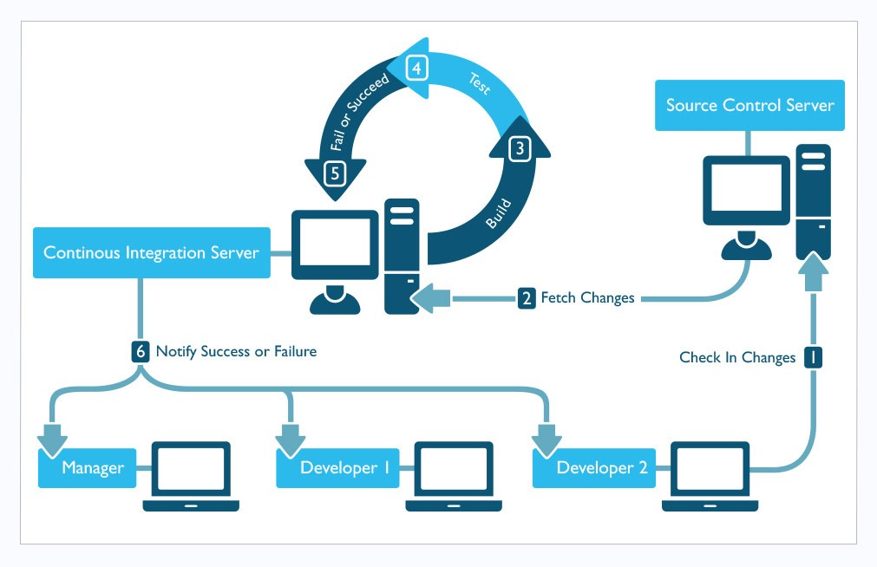
CI process

Slide 6
Source code control
Use a source control system
Subversion
Git
Everyone works from "trunk"
Branches kept to a minimum
Everything needed to build the project goes into source control

Slide 7
Code commit
Commit many times in a day at least once in a day
Do smaller commits as they are less risky
less chance of conflicts
conflicts are much easier to resolve
Each commit is atomic
work on a feature, commit a small, logical set of files
Do not commit code that breaks the build
You should not break the build!!!

Slide 8
Automate the build
Ensure that the build can be launched with a single command
Automated build should Include everything: Code, Configurations, other resource files
Finished build artifacts should be a complete running system on the local machine (or dev/test machine)
Keep the build fast.
Failed builds should be looked into immediately

Slide 9
Automate deployment
Install infrastructure software e.g. Tomcat
Setup/Configure infrastructure software
Deploy application build artifacts
Configure application
Create database
Import database
generate code

Slide 10
Automate Testing
Automate unit testing
Automate API testing
Automate GUI testing
Automate integration testing
Automate acceptance testing
Automate performance testing

Slide 11
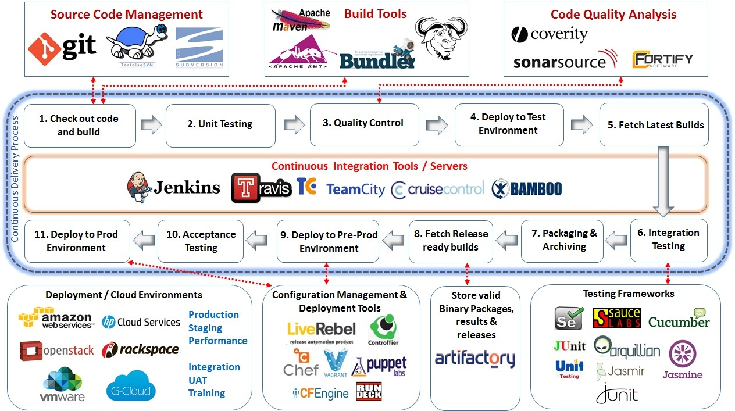
CI tools

Slide 12
CD definition
Continuous delivery (CD) is a software engineering approach in which teams produce software in short cycles, ensuring that the software can be reliably released at any time.^{[1]} It aims at building, testing, and releasing software faster and more frequently. The approach helps reduce the cost, time, and risk of delivering changes by allowing for more incremental updates to applications in production. A straightforward and repeatable deployment process is important for continuous delivery.

Slide 13
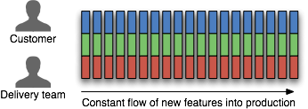
What is CD

Slide 14
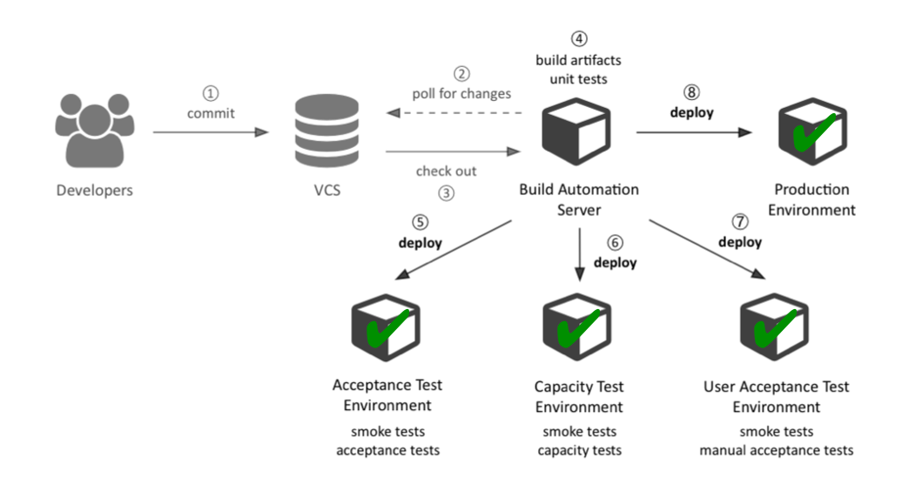
CD pipeline

Slide 15
CD practices
Only build your binaries once
Deploy the same way to every environment
Smoke test your deployments
Keep your environments similar
If anything fails, stop the CD pipeline
Create a repeatable, reliable process for releasing software
Automate almost everything
everybody is responsible for delivery
continuous improvement
Notes:
Configuration is your code
Developers are responsible for code – make them fix it
Triage the problem, some one get to fix it.

Slide 16
CD advantages
Consumer feedback
Small releases reduce risk
Easy rollback
Less pain, push button deployment
Less deployment errors

Slide 17
Ci cd demo
https://www.youtube.com/watch?v=jm0HEvxEChE

Slide 18
http://martinfowler.com/articles/continuousIntegration.html
http://martinfowler.com/bliki/ContinuousDelivery.html
https://en.wikipedia.org/wiki/Continuous_integration
https://en.wikipedia.org/wiki/Continuous_delivery

